Slide 1
Software Engineering and Architecture
Refactoring and Integration Testing
The power of automated tests

Slide 2
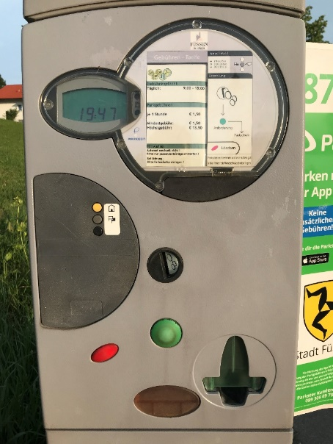
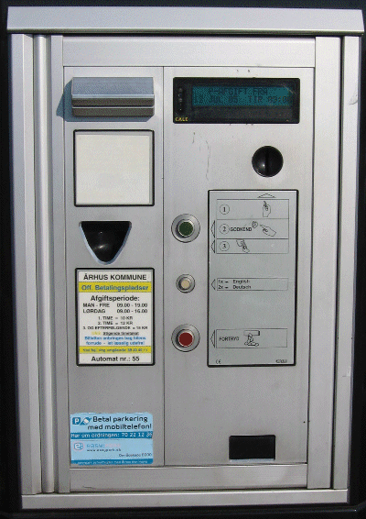
Two product variants
Alphatown and Betatown
Four models to handle this
compositional proposal has nice properties...
How do we introduce that?

Slide 3
Change by addition
I state:
Change by addition, not modification
because
addition
little to test, little to review
little chance of introducing ripple-effects
modification
more to test, more to review
high risk of ripples leading to side effects (bugs!)

Slide 4
The Problem Statement
But I have to modify the pay station implementation in order to prepare it for the new compositional design that uses a Strategy pattern
☹ Change by modification
Problem:
How to reliably modify PayStationImpl?
How can I stay confident that I do not accidentally introduce any defects?

Slide 5
Take Small Steps
I will stay focused and take small steps!
I have two tasks
1) Refactor the current implementation to introduce the Strategy and make AlphaTown work with new design
2) Add a new strategy to handle Betatown requirements
... and I will do it in that order – small steps!

Slide 6

Refactoring
Definition:
Refactoring is the process of changing a software system in such a way that is does not alter the external behavior of the code yet improves its internal structure.
Fowler, 1999

Slide 7
Iteration 1
Refactoring step

Slide 8
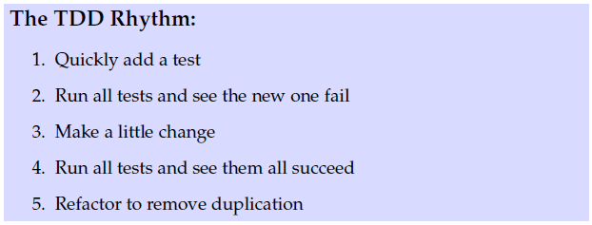
The Rhythm
Refactoring and the rhythm
Same spirit, but step 1+2+3 becomes “refactor”
1+2+3: Refactor

Slide 9
A faster way than in the FRS book
Use the tools in your IDE

Slide 10
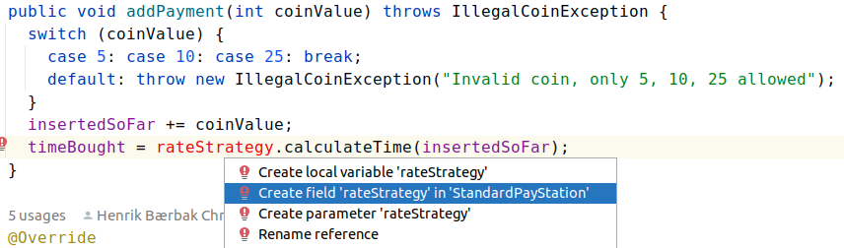
Simply type what you want
And ask the IDE (Alt-Enter) to suggest what to do,
And then just tell it what you want and it will fill in the template

Slide 11
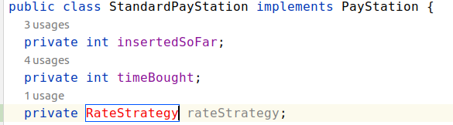
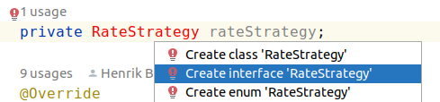
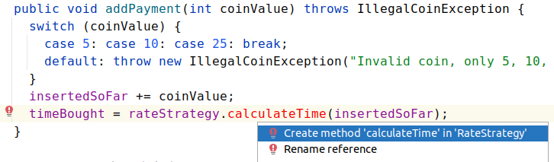

Slide 12
The 7 Inch Nail…
To repeat
Introduce design changes in two ‘small steps’:
Use existing test cases to refactor code so it has new design Do not change existing behavior!
Only then do you start test-driving the new feature(s) into your codebase.

Slide 13
Discussion

Slide 14
Why TDD?
Traditionally, developers see tests as
boring
time consuming
Why? Because of the stakeholders that benefit from tests are not the developers
customers: ensure they get right product ☺
management: measure developer productivity ☺
test department: job security ☺
developers: seemingly no benefit at all ☹

Slide 15
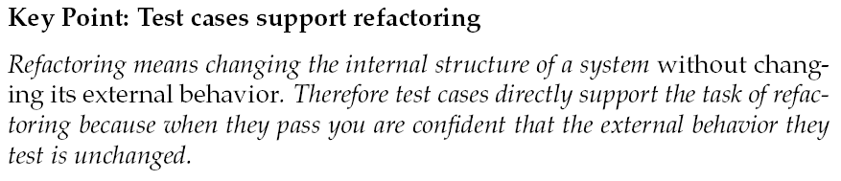
If it ain’t broke...
If it ain’t broke, don’t fix it
…is the old saying of fear-driven programming
Developers and programmers do not dare doing drastic design and architecture changes in fear of odd side-effects.

Slide 16

Test Ownership
Refactoring makes developers want to have ownership of the tests:
Automatic tests is the developers’ means to be courageous and to dare modify existing production code.
Michael Feathers:
Software Vise: Fixating the behavior

Slide 17
…But
The brittleness of the test cases hinges on only using the interfaces to the widest possible extend!
☺ assertThat(game.getCardInHand(…), is….)
☹ assertThat(asStdGame.getInternalDataStruture() .getAsArray()[47], is …)
Ensure your test cases does not rely on implementation details…

Slide 18
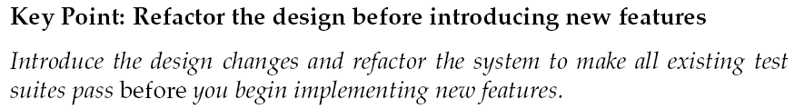

When redesigning....
TDD often seems like a nuisance to students and developers until the first time they realize that they dare do things they previously never dreamed of!
The first time a major refactoring is required – the light bulb turns on ☺

Slide 19
A Side Note
Tests allow ‘hypotheses’ to be verified quickly…

Slide 20
An Example
2023 discussion forum question
‘Why that Status.NOT_ALLOWED_TO_ACT_ON_BEHALF…?’
That is – what purpose does that particular value serve?
Good question?
The history of that is, well history! Code evolves, ideas are tried out, sometimes they are essential, sometimes not, so is it vital that this status value is kept? Or, can I delete it?
How to I find the answer to that?
By using my tests! The software Vise…

Slide 21
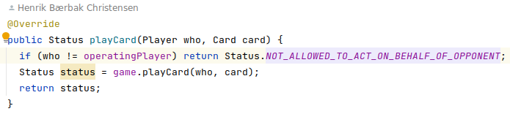
An Example
So – I use IntelliJ to find uses of that value. And find a couple of places, one example being
The ‘what if’ scenario
Use your tests to see what happens if…
If I replace it by NOT_OWNER???
Why can this ‘what if’ test provide value?

Slide 22
What If
The point here is:
If 1 out of 95 test cases break, then…
If 92 out of 95 test cases break, then …
Yeah – then what?
The “blast radius” is estimated
Will this have small or large implications?

Slide 23
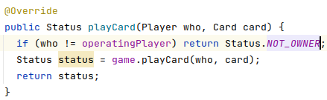
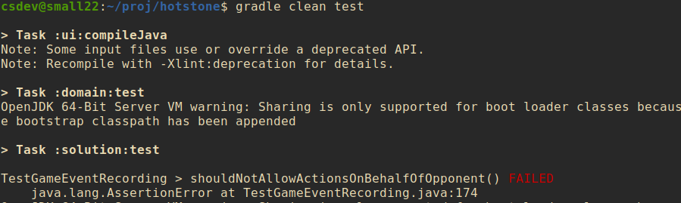
What If game
So I make that change (temporarily) to assess
Run all tests…
… to see only a single fail!

Slide 24
Conclusion
For the domain code (game code), it seems that particular Status value does not provide any value beyond what NOT_OWNER does.
It can probably be removed, the ‘blast area’ is small
Removed in the code base for the E24 instance
As UI operations are manually tested, I do still need to verify that aspect
Issue: Game domain works, but the UI fails…
But now my test cases include window driver tests…

Slide 25
Iteration 2
Betatown Rate Policy

Slide 26
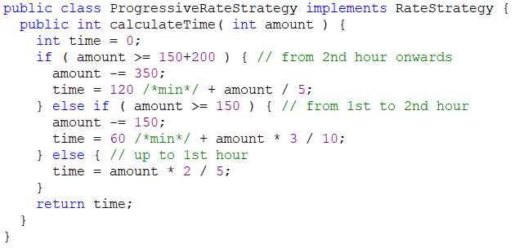
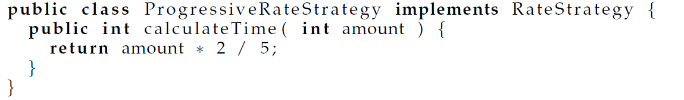
Triangulation at Algorithm Level
Introducing the real BetaTown rate policy is a nice example of using Triangulation
Iteration 2:
Add test case for first hour => production code
Iteration 3: Add test case for second hour
Add just enough complexity to the rate policy algorithm
Iteration 4: Add test case for third (and following) hour
Add just enough more complexity
Iteration 4
Iteration 3
Iteration 2

Slide 27
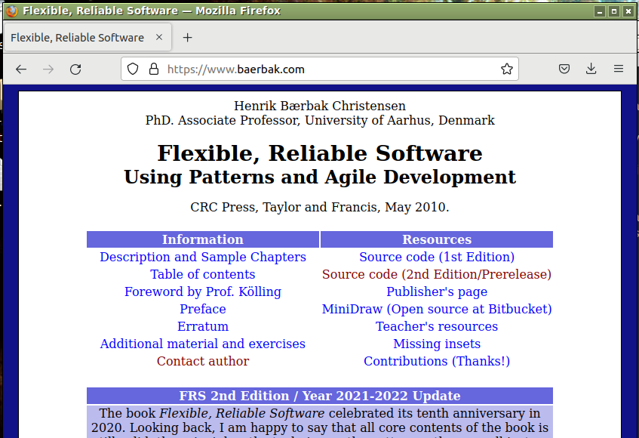

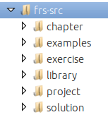
Uhum – the Details?

Slide 28
Iteration 5
Unit and Integration Testing

Slide 29
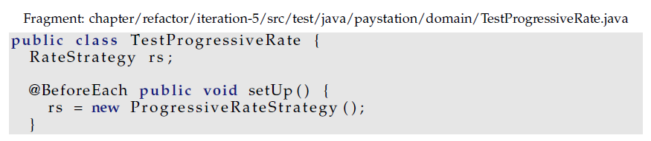
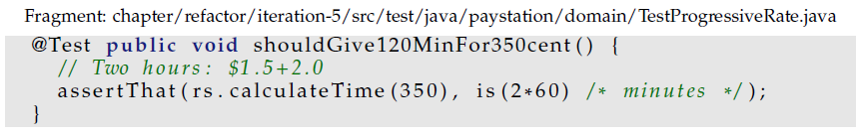
Unit Testing
I can actually test the new rate policy without using the pay station at all !

Slide 30
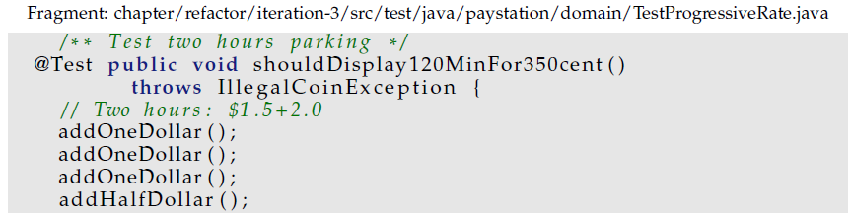
Advantages
The unit testing of the progressive rate strategy is much simpler than the corresponding test case, using the strategy integrated into the pay station.
Compare to

Slide 31
Testing Types
Now
I test the ProgressiveRateStrategy in isolation of the pay station (Unit testing)
The pay station is tested integrated with the LinearRateStrategy (Integration testing)
Thus the two rate strategies are tested by two approaches
In isolation (unit)
As part of another unit (integration)
And
The actual Betatown pay station is never tested!

Slide 32
Visually
AlphaTown - JUnit
PayStation
LinearRateStrategy
PayStation
BetaTown - JUnit
ProgressiveRate Strategy

Slide 33
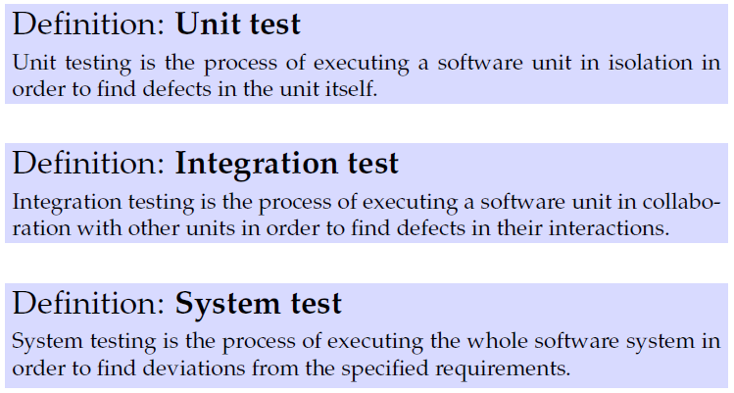
Definitions
Experience tells us that testing the parts does not mean that the whole is tested!
Often defects are caused by interactions between units or wrong configuration of units!
Algorithms – Business Logic
Collaboration between units/modules/services
User Expectations

Slide 34
Exercise
Tricky – but
Give me a concrete example where having tested all the units in isolation does not guaranty that the system works correctly!
Example: The Mars Climate Orbiter...
Notes:
Mars Climate orbiter: two subsystems communicating, one using metric and one using non-metric. Crashing cost $125 mio dollars.

Slide 35
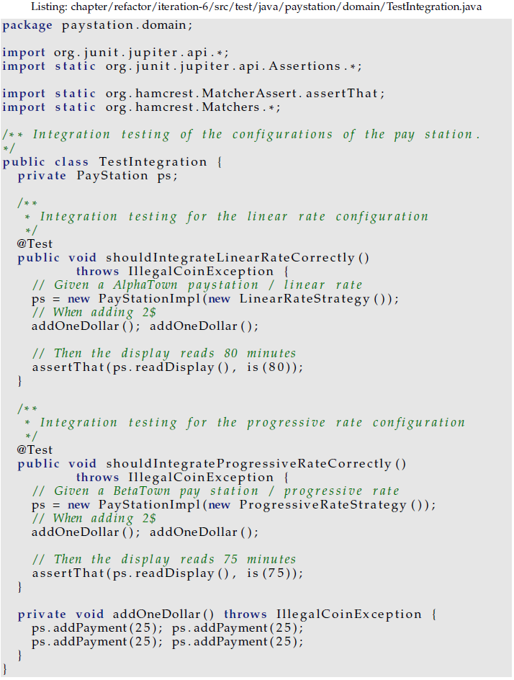
Integration Testing the Pay Station
I must add a testcase that validate that the AlphaTown and as well as BetaTown products are correctly configured!
Just a single test that they integrate!
Not repeating all the tests!
PayStation
Beta - JUnit
ProgressiveRate Strategy

Slide 36
Important Note!
Integration testing is not system testing!
You typically integration test that A works with B, while using doubles for C, D, and E units!
We will return to what ‘doubles’ are next week ☺
System testing is testing the full system: A working with real B, real C, real D, and real E units.
Focus: Does system do what it promised to do?

Slide 37
More advanced integration testing
The pay station case’s integration is pretty simple as it is all a single process application.
SkyCave case
Automated integration tests use special libraries to start a MongoDB database and an external REST server, in order to test the main server’s proper interaction with these.
Afterwards the database + REST server is stopped and wiped for contents
Integration tests are often slow to execute
Which is why they are often performed by a special build server…

Slide 38
And system testing
Karibu case
(Manual) system test requires
Two servers running clustered RabbitMQ
Two servers running Karibu Daemons
Three servers running replica set Mongo databases
Test cases include
Shutting down servers and validate data keeps flowing and reviewing log messages for proper handling of shut down events...

Slide 39
Iteration 6: Unit Testing Pay Station

Slide 40
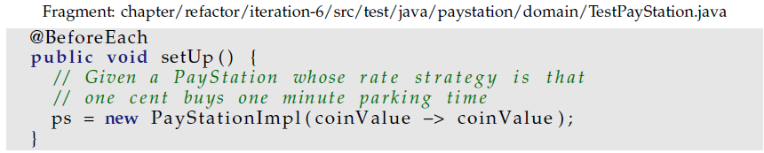
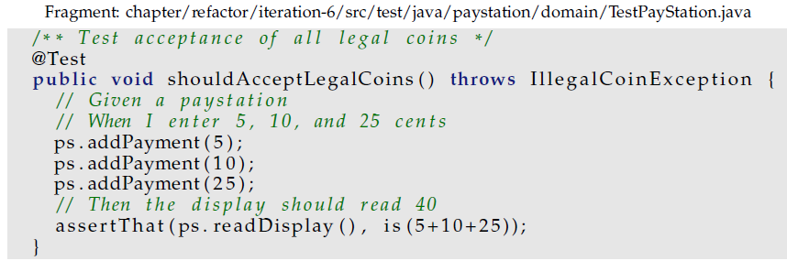
Separate Testing
I can actually also apply Evident Test to the testing of the pay station by introducing a very simple rate policy
Lambda expression for: one cent = one minute

Slide 41
Visually
Now unit testing PayStation
As the RateStrategy is ‘doubled’ by a simpler implementation
Simpler => No defects there, so any defect must stem from coding errors in the PayStation…
PaySt. - JUnit
PayStation
One2OneRateStrategy
LinearRateStrategy

Slide 42
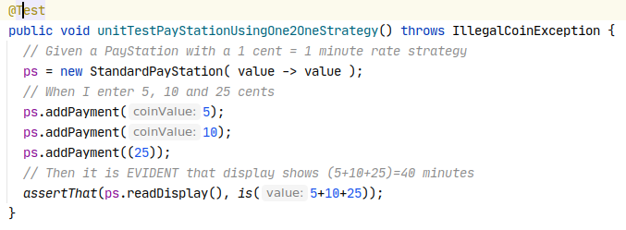
Resulting test cases
Using this rate policy makes reading pay station test cases much easier!

Slide 43
Outlook
Continuous Delivery and Deployment

Slide 44
Agile on the Minute Scale
Many software houses release and deploy software on the minute and hour scale
Google, netflix, uber, amazon, microsoft, …
How
Comprehensive unit test suites
Comprehensive integration tests
Automated ‘build pipelines’ running on dedicated build servers
The pipeline will
Run all tests, package the system into a virtual machine and release it
Potentially deploy the release and put it into production

Slide 45
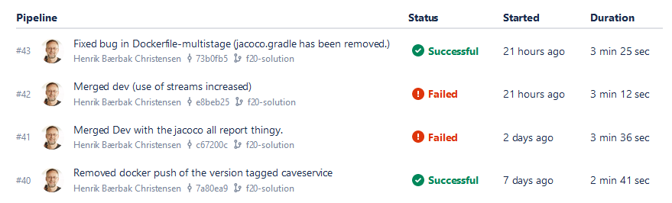
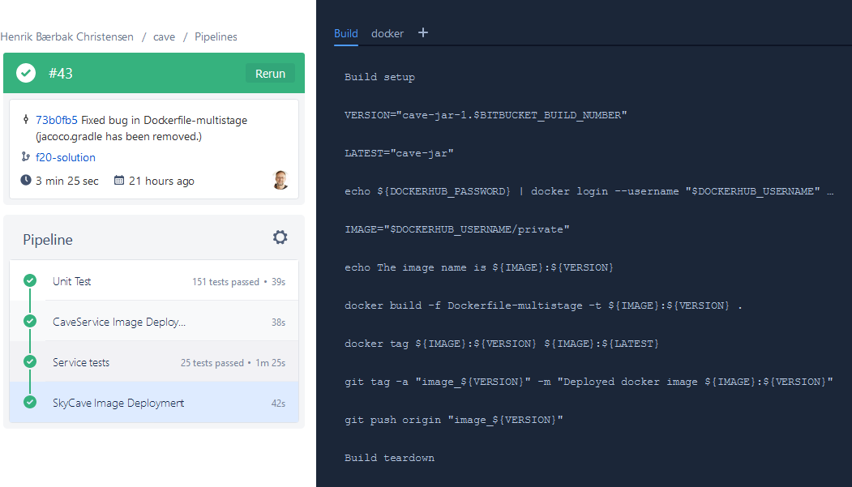
Example: Bitbucket Pipelines

Slide 46
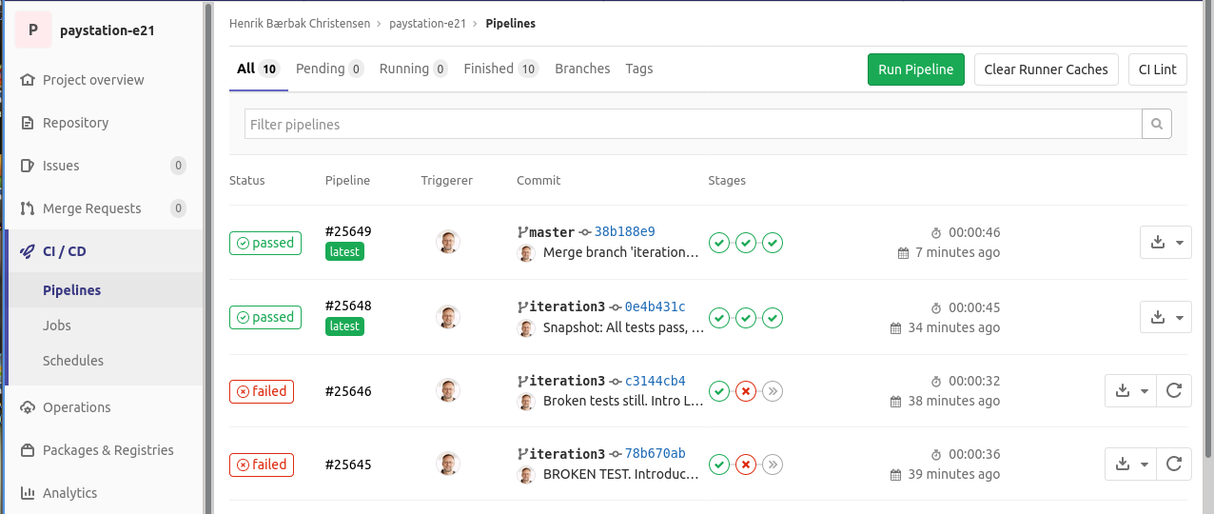
AU GitLab supports it
You can enable it by adding a special ‘yml’ file…

Slide 47
Conclusion

Slide 48
Advice
Do not code in anticipation of need, code when need arise...
Automatic tests allow you to react when need arise
because you dare refactor your current architecture...

Slide 49
Refactoring
When ’architecture refactoring’ need arise then
A) Use the old functional tests to refactor the architecture without adding new or changing existing behavior
B) When everything is green again then proceed to introduce new/modified behavior
C) Review again to see if there is any dead code lying around or other refactorings to do.
Notes:
Regarding C: In a project I did I changed the persistence structure from reading/writing flat files into internal datastructures to using a light-weight SQL database. After the refactoring there were several methods left from the interface that was geared at sequential reading the data into memory that was now of little use.

Slide 50
Discussion
These refactorings shown here are very local, so the ‘architecture decisions’ are also local.
However sometimes you need to make larger architectural changes that invalidate the test cases ☹
Changing API or the way units are used
Ex: Changing persistence from file to RDB based
What to do in this case?
Define a path (even a long one) of small tasks that keep tests running! Even if it means making code that later must be removed

